Slide 1
ASP.NET MVC Forms and Validation

Slide 2
Table of Contents
HTML Forms
Ajax form submit
JavaScript validation
jQuery validation
Submit data, fields, objects
HTML Helpers
Model Validation Using Data Annotations
File upload

Slide 3
HTML Forms

Slide 4
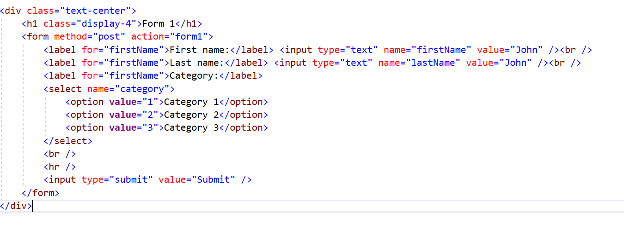
HTML Forms

Slide 5
Ajax form submit

Slide 6
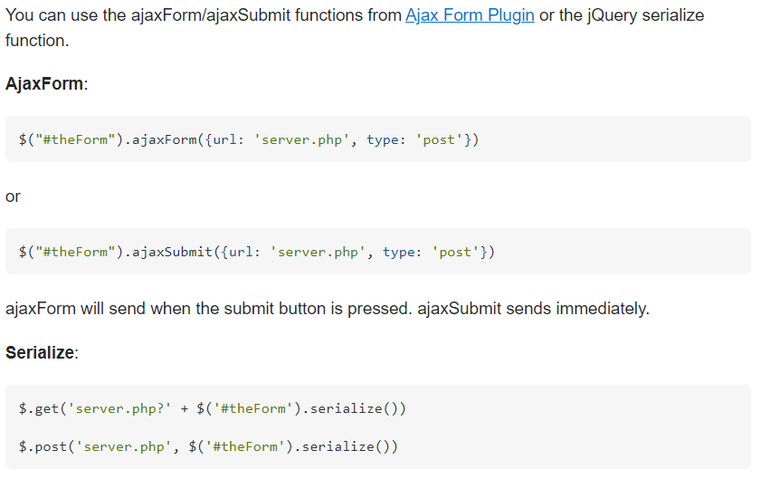
Ajax form submit

Slide 7
JavaScript validation

Slide 8
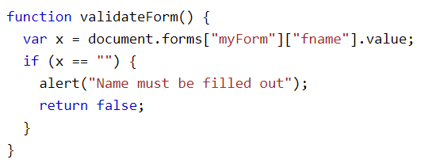
JavaScript validation
https://www.w3schools.com/js/js_validation.asp

Slide 9
jQuery validation

Slide 10
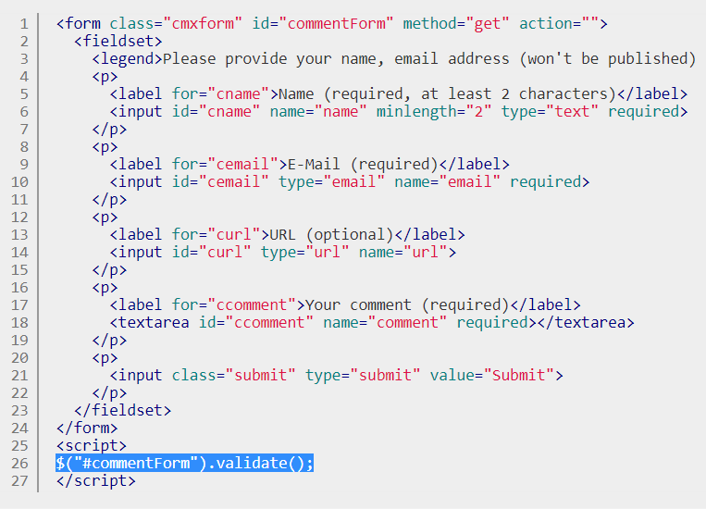
jQuery Validation
https://jqueryvalidation.org/documentation/

Slide 11
Submit data, fields, objects

Slide 12
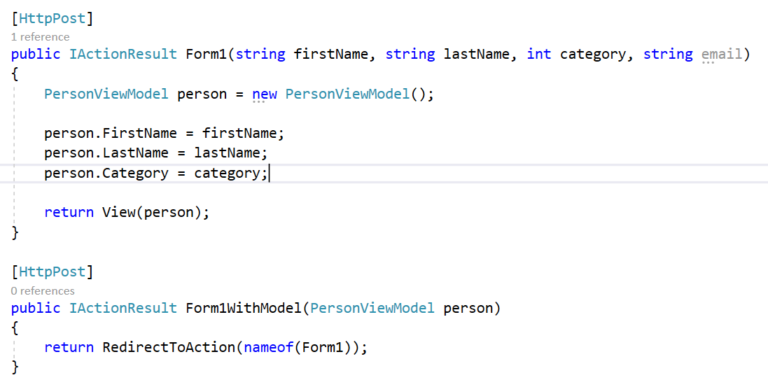
Submit data, fields, objects

Slide 13
HTML Helpers
https://www.tutorialsteacher.com/mvc/html-helpers

Slide 14
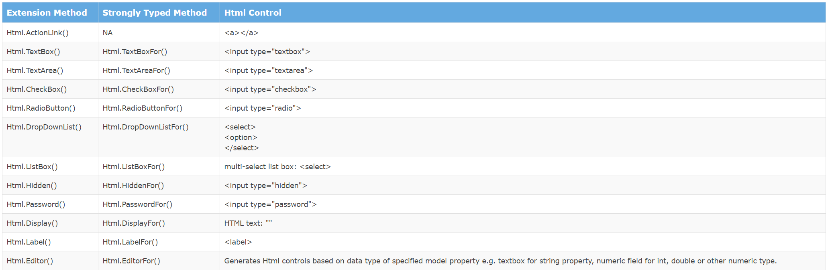
HTML Helpers
The following table lists the HtmlHelper methods and HTML control each method renders.

Slide 15
Model Validation Using Data Annotations

Slide 16
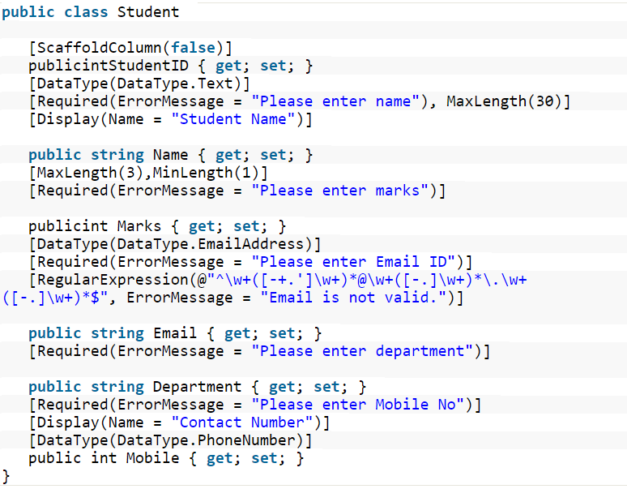
Model Validation Using Data Annotations
https://www.c-sharpcorner.com/article/model-validation-using-data-annotations-in-asp-net-mvc/

Slide 17
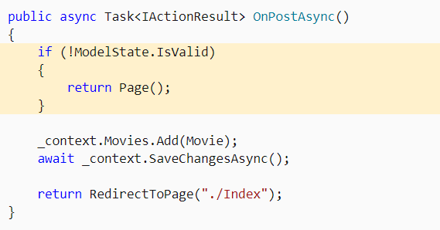
Model Validation
https://docs.microsoft.com/en-us/aspnet/core/mvc/models/validation?view=aspnetcore-5.0

Slide 18
Upload file

Slide 19
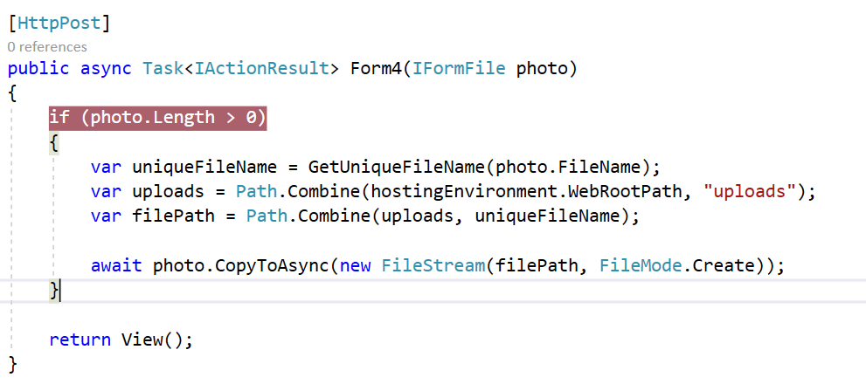
Upload file
https://docs.microsoft.com/en-us/aspnet/core/mvc/models/file-uploads?view=aspnetcore-5.0

Slide 20
References
https://www.tutorialspoint.com/asp.net_core/asp.net_core_configuration.htm
https://www.tutorialsteacher.com/core
https://www.tutorialsteacher.com/ioc
https://www.tutorialspoint.com/asp.net_core/index.htm
https://docs.microsoft.com/en-us/aspnet/core/tutorials/first-mvc-app/start-mvc
https://docs.microsoft.com/en-us/aspnet/core/fundamentals/logging

Slide 21
Homework – Registration Form
Create new ASP.NET Core MVC web project using the default template
Create a registration form with appropriate validation, containing following fields:
First name – string, required
Last name – string, required
Email – email, required
Gender – radio button with options man, woman, other
Subscribe me – checkbox, Boolean
Country – list of countries, required
Photo – file

